Slide 1
Hole Escaping
Team Sprite

Slide 2
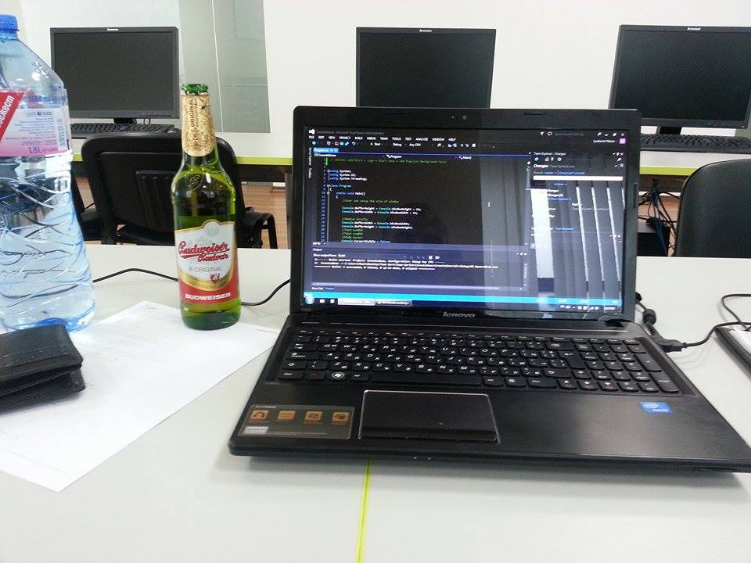

Slide 3
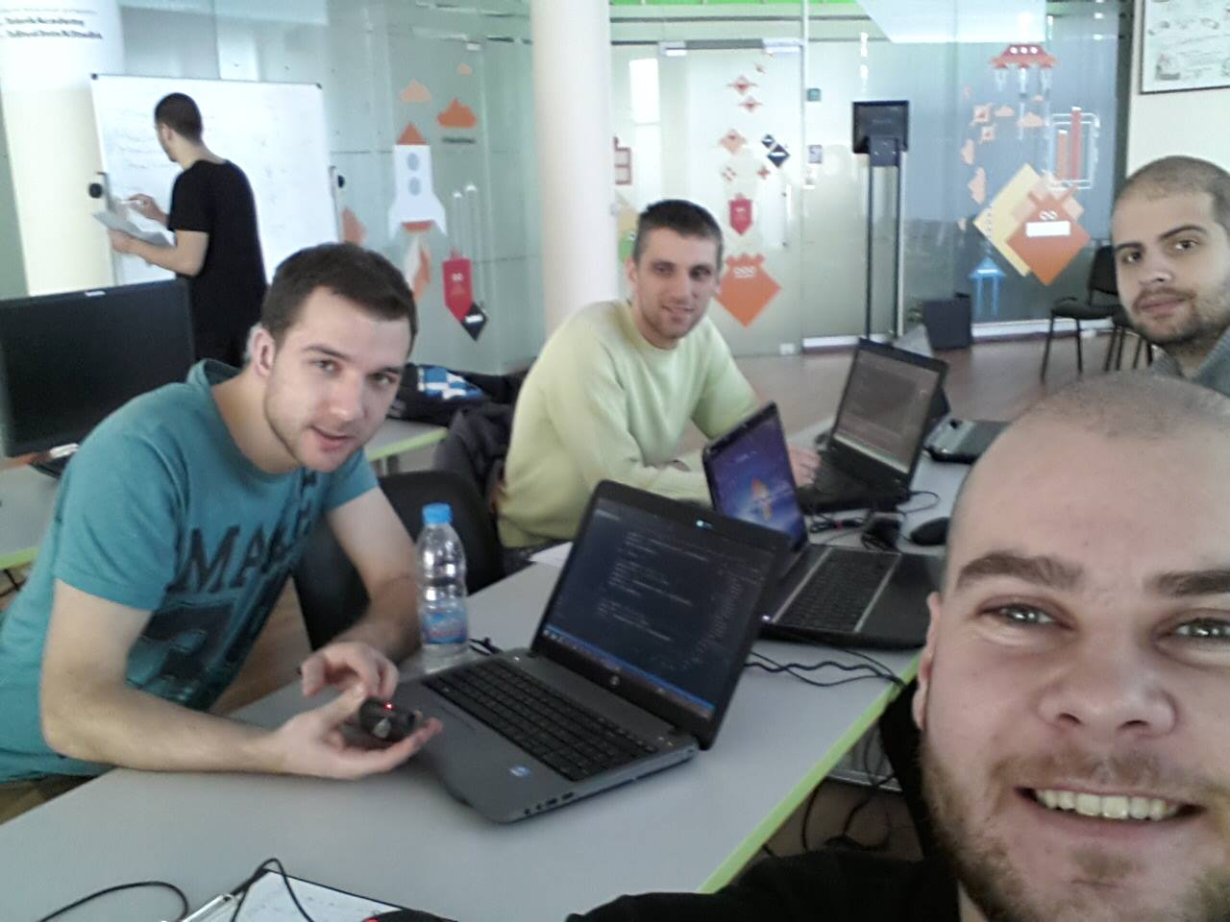

Slide 4


Slide 5

The beginning

Slide 6
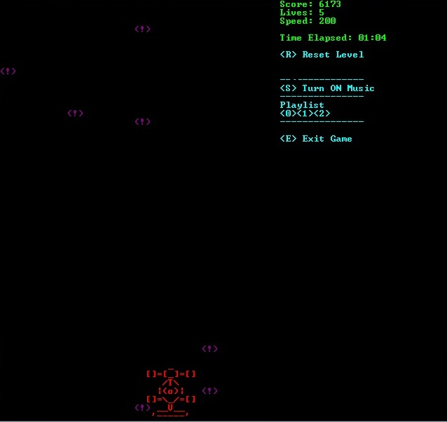
Fixing bugs

Slide 7
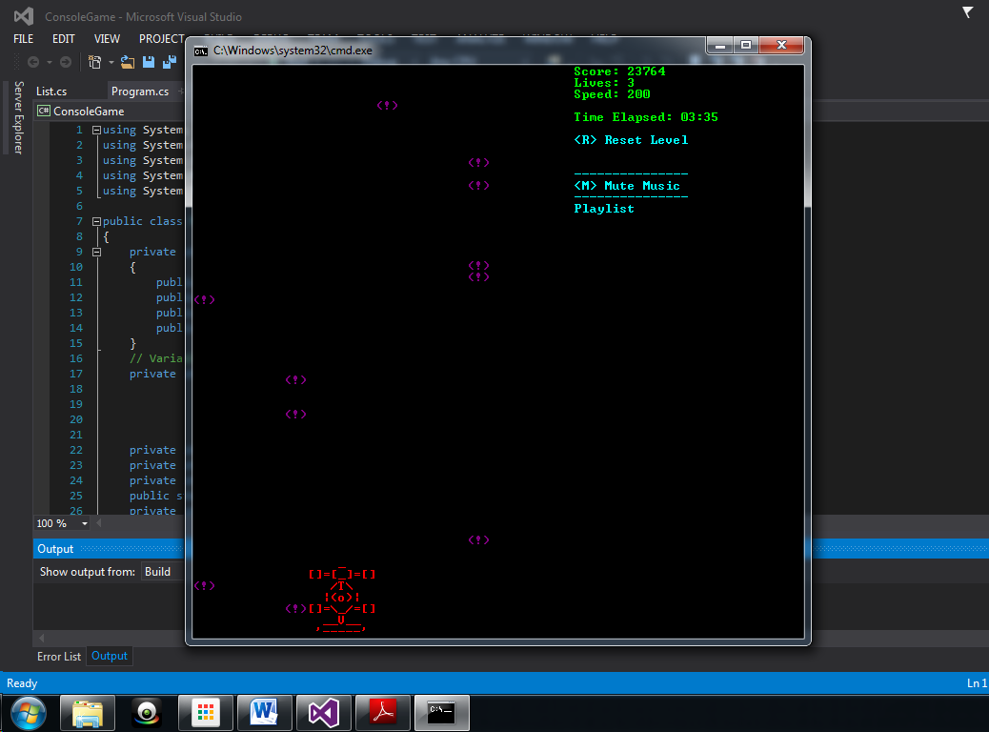

Slide 8
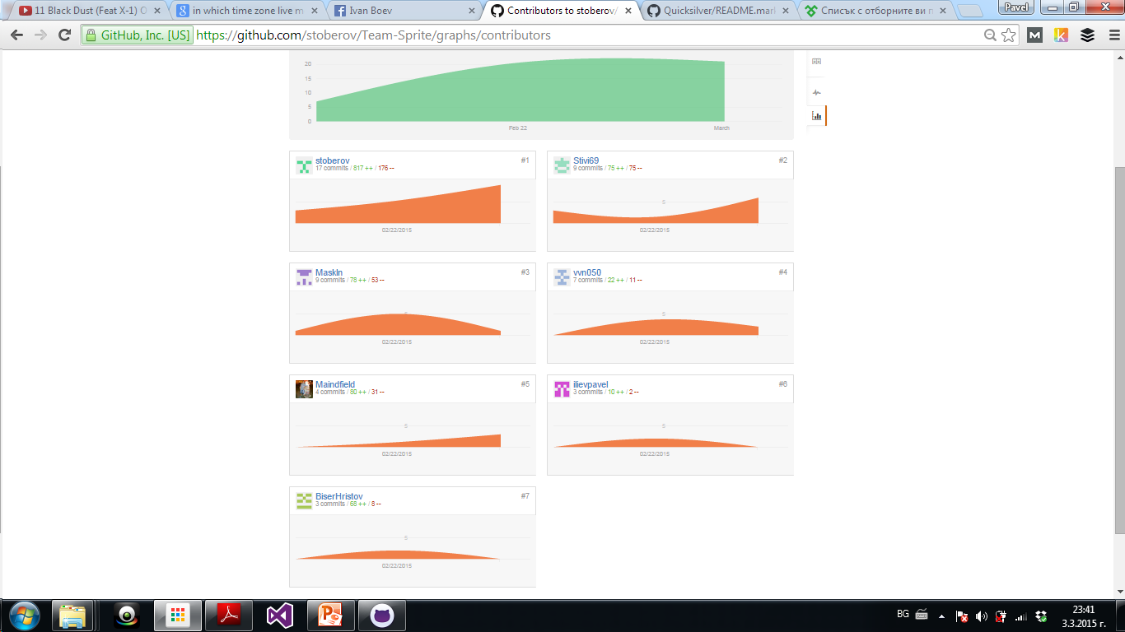

Slide 9
Thanks for watching!
The crew
Pavel Iliev
Georgi Rizov
Lubomir Nanev
Biser Hristov
Stoyan Berov
Vladislav Nikolov
Stanimir Stratiev

